Slide 1
Aggregation and Grouping operations
Aggregate function, group by and having

Slide 2
Introduction
As well as simply retrieving certain tuples and attributes of one or more relations,
we often want to perform some form of summation or aggregation of data,
Similar to the totals at the bottom of a report, or
Some form of grouping of data, similar to subtotals in a report.
These operations cannot be performed using the basic relational operations considered earlier.
However, additional operations have been proposed.

Slide 3
Aggregate operation
The ISO standard defines five aggregate functions:
COUNT – returns the number of values in the associated attribute.
SUM – returns the sum of the values in the associated attribute.
AVG – returns the average of the values in the associated attribute.
MIN – returns the smallest value in the associated attribute.
MAX – returns the largest value in the associated attribute.

Slide 4
Aggregate operation…
These functions operate on a single column of a table and return a single value.
COUNT, MIN, and MAX apply to both numeric and nonnumeric fields,
SUM and AVG may be used on numeric fields only.
Apart from COUNT(*), each function eliminates nulls first and operates only on the remaining non-null values.

Slide 5
Aggregate operation…
COUNT(*) is a special use of COUNT that counts all the rows of a table,
regardless of whether nulls or duplicate values occur.
To eliminate duplicates before the function is applied,
Use the keyword DISTINCT before the column name in the function.
The ISO standard allows the keyword ALL to be specified if we do not want to eliminate duplicates,
ALL is assumed if nothing is specified.

Slide 6
Aggregate operation…
DISTINCT has no effect with the MIN and MAX functions.
It may have an effect on the result of SUM or AVG,
Consideration must be given to whether duplicates should be included or excluded in the computation.
DISTINCT can be specified only once in a query.

Slide 7
Aggregate operation…
An aggregate function can be used only in the SELECT list and in the HAVING clause
If the SELECT list includes an aggregate function and no GROUP BY clause to group data together,
No item in the SELECT list can include any reference to a column unless that column is the argument to an aggregate function.
For example, the following query is illegal:

Slide 8
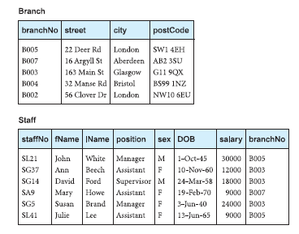
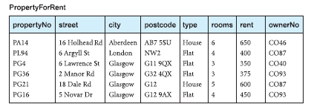
Aggregate operation…

Slide 9
Aggregate operation…
SELECT staffNo, COUNT(salary)
FROM Staff;
Illegal because the query does not have a GROUP BY clause and
the column staffNo in the SELECT list is used outside an aggregate function.

Slide 10
Use of count(*)
How many properties cost more than £350 per month to rent?
SELECT COUNT(*) AS myCount
FROM PropertyForRent
WHERE rent > 350;
myCount
5
Restricting the query to properties that cost more than £350 per month is achieved using the WHERE clause.

Slide 11
Use of count(*)…
The total number of properties satisfying this condition can then be found by applying the aggregate function COUNT.

Slide 12
Use of COUNT(DISTINCT)
How many different properties were viewed in May 2013?
SELECT COUNT(DISTINCT propertyNo) AS myCount
FROM Viewing
WHERE viewDate BETWEEN ‘1-May-13’ AND ‘31-May-13’;
myCount
2
Again, restricting the query to viewings that occurred in May 2013 is achieved using the WHERE clause.

Slide 13
Use of COUNT(DISTINCT)…
The total number of viewings satisfying this condition can then be found by applying the aggregate function COUNT.
As the same property may be viewed many times,
Use the DISTINCT keyword to eliminate duplicate properties

Slide 14
Use of COUNT and SUM
Find the total number of Managers and the sum of their salaries.
SELECT COUNT(staffNo) AS myCount, SUM(salary) AS mySum
FROM Staff
WHERE position = ‘Manager’;
myCount mySum
2 54000.00

Slide 15
Use of COUNT and SUM…
Restricting the query to Managers is achieved using the WHERE clause.
The number of Managers can be found by applying the COUNT and
The sum of their salaries can be found by applying the SUM functions respectively to this restricted set.

Slide 16
Use of MiN, MAX, AVG
Find the minimum, maximum, and average staff salary.
SELECT MIN(salary) AS myMin, MAX(salary) AS myMax, AVG(salary) AS myAvg
FROM Staff;
myMin myMax myAvg
9000.00 30000.00 17000.00

Slide 17
Use of MiN, MAX, AVG…
In this example, all staff are considered, no WHERE clause required.
The values can be calculated using the MIN, MAX, and AVG functions based on the salary column.

Slide 18
Grouping results (group by)
These queries are similar to the totals at the bottom of a report.
They condense all the detailed data in the report into a single summary row of data.
However, it may be useful to have subtotals in reports.
Use the GROUP BY clause of the SELECT statement to do this.

Slide 19
Grouping results (group by)…
A query that includes the GROUP BY clause is called a grouped query,
It groups the data from the SELECT table(s) and produces a single summary row for each group.
The columns named in the GROUP BY clause are called the grouping columns.
The ISO standard requires the SELECT clause and the GROUP BY clause to be closely integrated.

Slide 20
Grouping results (group by)…
When GROUP BY is used, each item in the SELECT list must be single-valued per group.
In addition, the SELECT clause may contain only:
column names;
aggregate functions;
constants;
an expression involving combinations of these elements.

Slide 21
Grouping results (group by)…
All column names in the SELECT list must appear in the GROUP BY unless the name is used only in an aggregate function.
The contrary is not true:
there may be column names in the GROUP BY clause that do not appear in the SELECT list.
When the WHERE clause is used with GROUP BY;
the WHERE clause is applied first,

Slide 22
Grouping results (group by)…
then groups are formed from the remaining rows that satisfy the search condition.
The ISO standard considers two nulls to be equal for purposes of the GROUP BY clause.
If two rows have nulls in the same grouping columns and identical values in all the non-null grouping columns, they are combined into the same group.

Slide 23
Use of GROUP BY
Find the number of staff working in each branch and the sum of their salaries.
SELECT branchNo, COUNT(staffNo) AS myCount, SUM(salary) AS mySum
FROM Staff
GROUP BY branchNo
ORDER BY branchNo;
It is not necessary to include the column names staffNo and salary in the GROUP BY list,

Slide 24
Use of GROUP BY…
They appear only in the SELECT list within aggregate functions.
On the other hand, branchNo is not associated with an aggregate function and so must appear in the GROUP BY list.
branchNo myCount mySum
B003 3 54000.00
B005 2 39000.00
B007 1 9000.00

Slide 25
Use of GROUP BY…
Conceptually, SQL performs the query as follows:
SQL divides the staff into groups according to their respective branch numbers.
Within each group, all staff have the same branch number.
In this example, we get three groups:

Slide 26
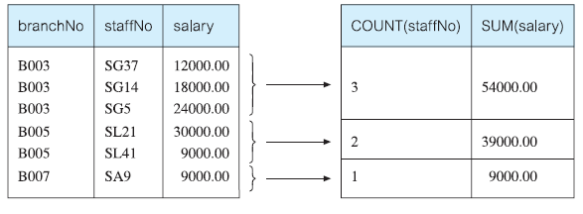
Use of GROUP BY…

Slide 27
Use of GROUP BY…
For each group, SQL computes the number of staff members,
Calculates the sum of the values in the salary column to get the total of their salaries.
SQL generates a single summary row in the query result for each group.
Finally, the result is sorted in ascending order of branch number, branchNo.

Slide 28
Restricting groupings (HAVING clause)
The HAVING clause is designed for use with the GROUP BY clause
It restricts the groups that appear in the final result table.
Like other keywords, it returns the data that meet the condition and filters out the rest.
Although similar in syntax, HAVING and WHERE serve different purposes.
The WHERE clause filters individual rows going into the final result table,
whereas HAVING filters groups going into the final result table

Slide 29
Restricting groupings (HAVING clause)…
The ISO standard requires that column names used in the HAVING clause must also appear in the GROUP BY list or
be contained within an aggregate function.
In practice, the search condition in the HAVING clause always includes at least one aggregate function;
Otherwise the search condition could be moved to the WHERE clause and applied to individual rows.

Slide 30
Restricting groupings (HAVING clause)…
Remember that aggregate functions cannot be used in the WHERE clause.
The HAVING clause is not a necessary part of SQL
Any query expressed using a HAVING clause can always be rewritten without the HAVING clause.

Slide 31
Use of HAVING
For each branch office with more than one member of staff, find the number of staff working in each branch and the sum of their salaries.
SELECT branchNo, COUNT(staffNo) AS myCount, SUM(salary) AS mySum
FROM Staff
GROUP BY branchNo
HAVING COUNT(staffNo) > 1
ORDER BY branchNo;

Slide 32
Use of HAVING…
This restriction applies to the groups, so the HAVING clause is used.
branchNo myCount mySum
B003 3 54000.00
B005 2 39000.00

